Slide 1
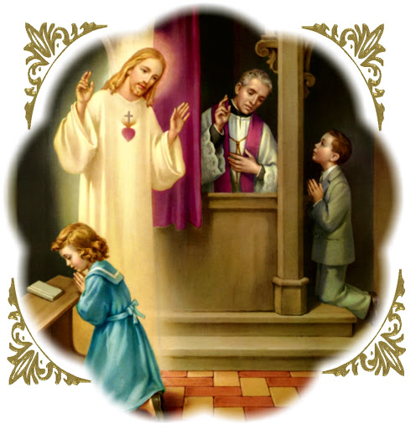
EXAMINATION OF CONSCIENCE FOR CHILDREN

Slide 2
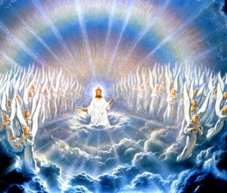
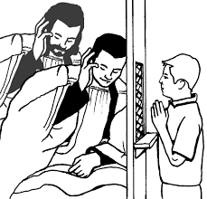
THE FIRST COMMANDAMENT: I am the Lord your God. You shall have no other gods before me
Do I pray everyday?
Do I put my trust in superstitions, good luck charms, rather than God alone?
Do I worship only God?

Slide 3
The Second Commandment: You shall not take the name of the Lord your God in vain
Have I used the words “God” or “Jesus” to someone because I was mad?
Have I used bad words?

Slide 4
The Third Commandment: Remember to keep holy the Lord’s Day
Have I missed Mass on Sunday?
Do I pay attention during Mass?
Do I avoid unnecessary work on
Sunday a day of prayer and rest?

Slide 5
The Fourth Commandment: Honor your father and your mother
Do I obey my parents in what I say and do?
Do I give good example to my brothers and sisters?
Do I obey teachers, police,
elderly people and babysitters?

Slide 6
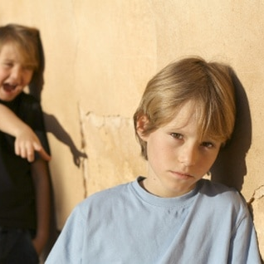
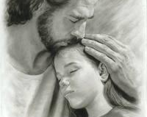
The Fifth Commandment: You shall not kill
Do I beat up others, hurt their bodies, say mean things about them or make fun of others to hurt feelings?
Have I stop speaking to anyone? Do I encourage others to do bad things or wish bad things to happen to others?
I am a tattletale or bully?

Slide 7
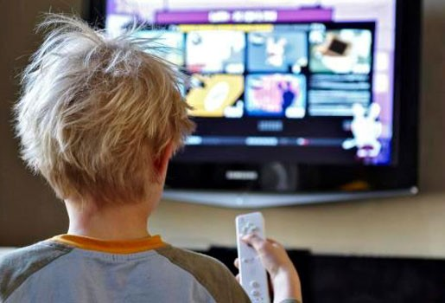
The Sixth Commandment You shall not commit adultery
Do I treat my body and other people’s bodies with respect?
Do I look TV, movies, pictures, videos, social media that are bad?
Do I speak nicely to others?

Slide 8
The Seventh Commandment You shall not steal
Have I taken things that were not mine from a store or another person?
Have I ruined another persons property for fun?
Do I return things that I borrow? In good condition?
This Photo by Unknown Author is licensed under CC BY-NC-ND
This Photo by Unknown Author is licensed under CC BY-ND

Slide 9
The Eighth Commandment You shall not lie
Am I honest in my schoolwork or cheat, copy other students work?
Do I tell lies to make myself look good or protect myself from punishment? Do I make others look bad or get them in trouble?

Slide 10
The Nineth Commandment: You shall not covet your neighbor’s wife
Do I allow my parents to spend time with one another, or do I get jealous and want them to pay attention only to me?
Do I get mad when I have to share my friends?
Are there children I will not play with or be mean to because they look different?

Slide 11
The Tenth Commandment: You shall not covet your neighbor’s goods
Am I jealous or envious of the things my friend have or because my friends can play sports better than I can?
Am I thankful to God and my parents for what they have given me?
Do I share the things I have with my family, friends and poor people?
This Photo by Unknown Author is licensed under CC BY-SA

